Slide 1
Ciência de Dados Quântica Variational Quantum Circuits: barren plateaus
Luís Paulo santos

Slide 2
Material de Consulta
[Schuld2021] – Sec. 5.3.3
[Tacchino2021] – 2021 Qiskit Global Summer School on Quantum Machine Learning: Barren Plateaus, Trainability Issues and How to Avoid Them https://learn.qiskit.org/summer-school/2021/lec8-2-barren-plateaus-trainability-issues-how-avoid-them
[Qiskit] –Qiskit Quantum Machine Learning Course: Training parameterized quantum circuits https://learn.qiskit.org/course/machine-learning/training-quantum-circuits
” A Review of Barren Plateaus in Variational Quantum Computing“ Larocca et al; May, 2024 arXiv:2405.00781

Slide 3




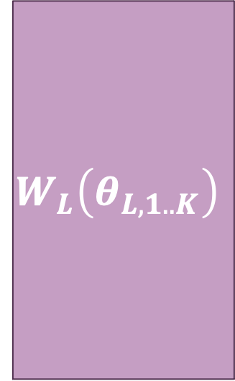



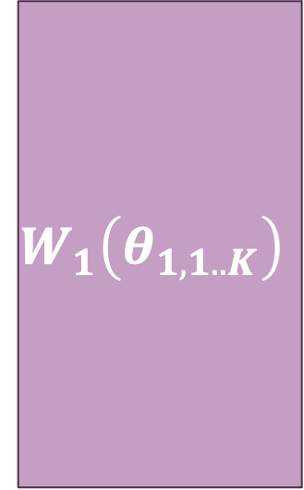

Parameterized quantum circuits
S$\left(x\right)$
$$W_{1}\left(θ_{1,1..K}\right)$$
$$W_{L}\left(θ_{L,1..K}\right)$$
$$M$$
$$M$$
$${\left.\left|0\right.\right\rangle }^{⨂n}$$
$$M$$
$$M$$
$$\hat{y}\left(x\right)=\left\langle 0 | U^{†}\left(x,\vec{θ}\right) M U\left(x,\vec{θ}\right) | 0\right\rangle$$
$$U\left(x,\vec{θ}\right)=\left[\prod_{l=1}^{L}{W_{l}\left({\vec{θ}}_{l}\right)}\right]S\left(x\right)=𝒲\left(\vec{θ}\right)S\left(x\right)$$

Slide 4
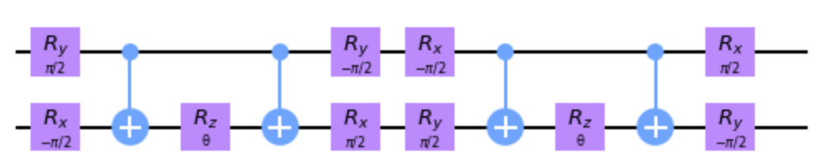
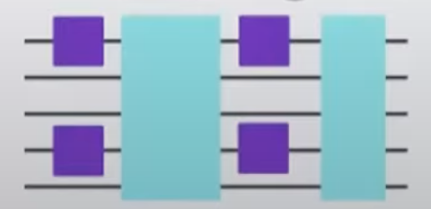
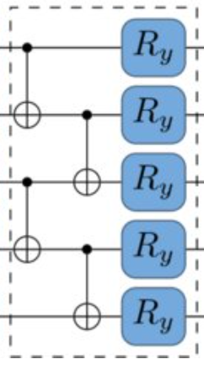

The ansatz
$$𝒲\left(x\right)$$
PROBLEM
SOLUTION
Problem Specific
Problem Agnostic / Hardware Efficient
Example: Chemistry ground state problems

Slide 5
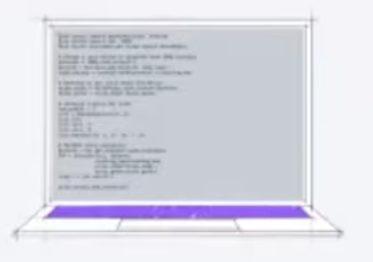
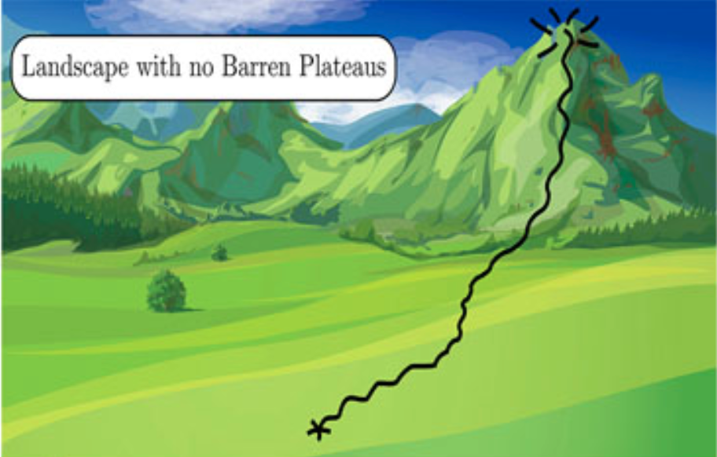
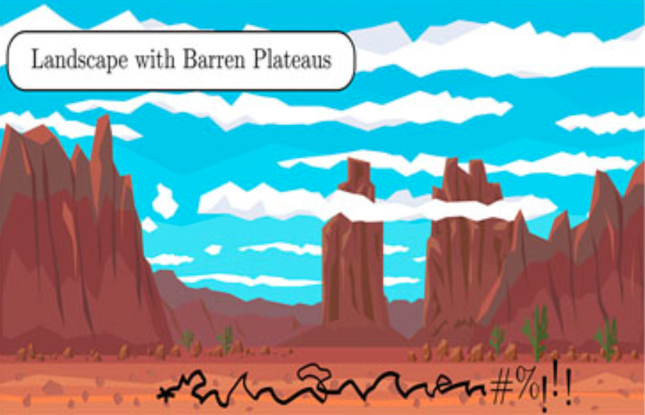







Vanishing Gradients / Barren plateaus
$$𝒲\left(x\right)$$
$${\left\langle O\right\rangle }_{θ^{t}}$$
Classical Optimization
$$θ^{t+1}=f\left(C\left(θ^{t}\right)\right)$$
$$θ^{t+1}$$
$$θ^{∗}=\underset{θ}{argmin}\left(C\left(θ\right)\right)$$

Slide 6


Vanishing Gradients / Barren plateaus
Hardware efficient ansatz
”Deep” random parameterized circuits : $depth\sim 𝒪(poly\left(n\right))$
Random initialization of parameters
$$\left\langle ∂_{θ_{k}}C\left(\vec{θ}\right)\right\rangle \sim 0$$
$$Var\left(∂_{θ_{k}}C\left(\vec{θ}\right)\right)\sim 𝒪\left(\frac{1}{2^{n}}\right)$$
Gradient vanishes exponentially fast with the number of qubits, $n$

Slide 7
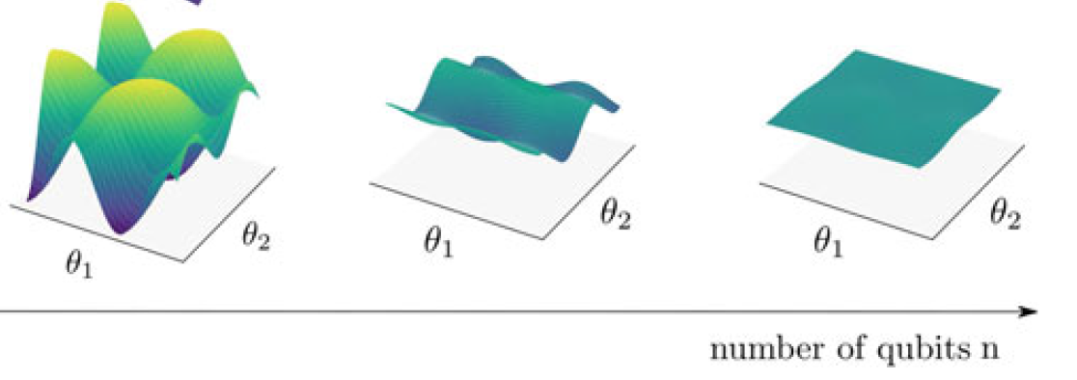
Barren plateaus
[Schuld2021]

Slide 8
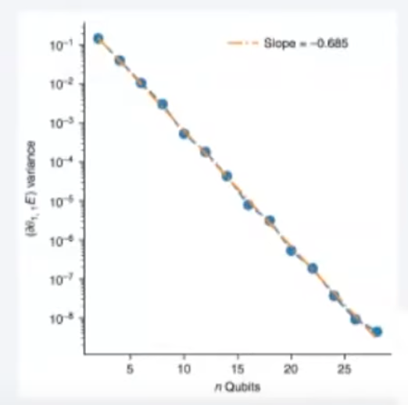
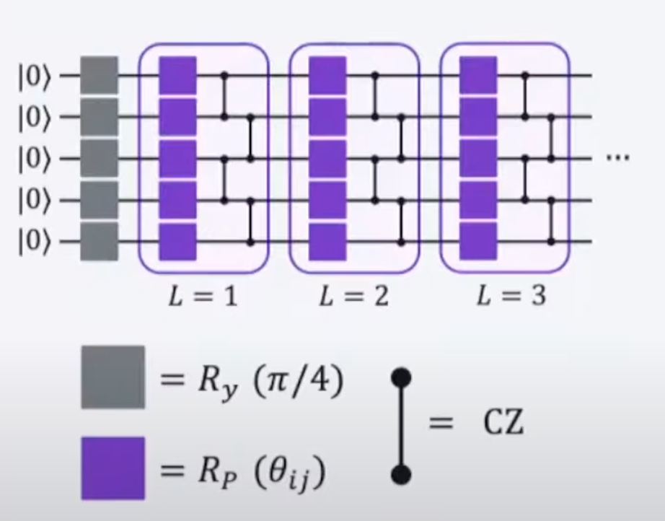

Barren Plateaus
The variance of the gradients decreases
exponentially with the number of qubits
$$L=10n\sim 𝒪\left(poly\left(n\right)\right)$$

Slide 9
Barren plateaus
The problem of barren plateaus becomes more acute as the number of qubits increases
Trainability becomes exponentially more difficult with the number of qubits
Interesting problems from the real world are expected to require a large number of qubits

Slide 10
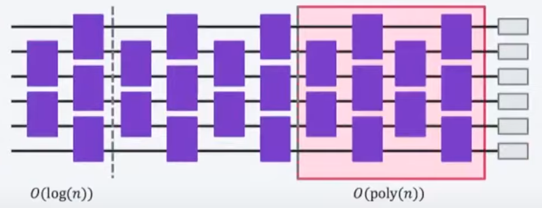
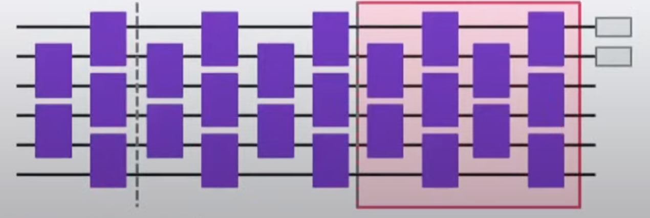
Observables
Global Observable
Local Observable

Slide 11
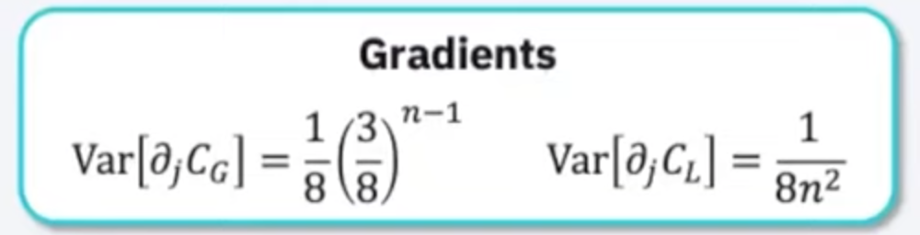
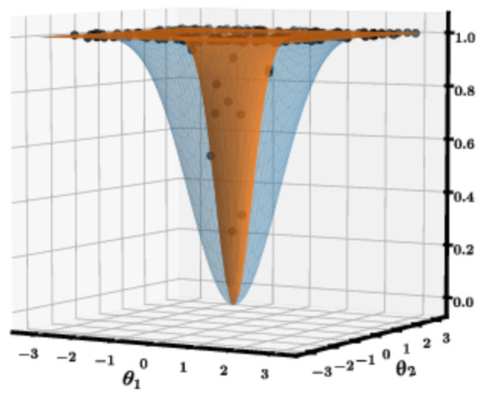
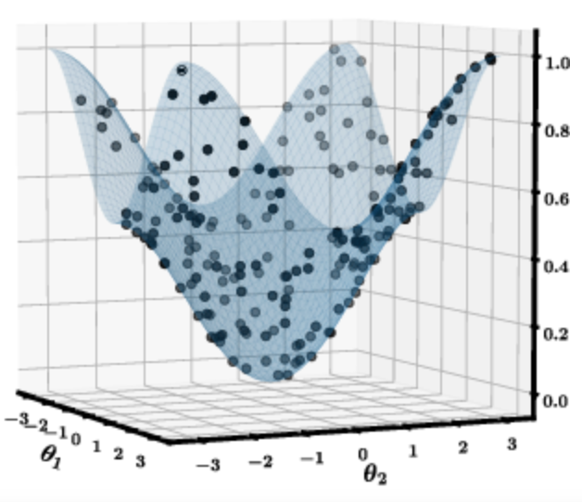
Vanishing Gradients
Local Observable
Global Observable

Slide 12

Vanishing Gradients
 |  | Depth
 |  | $$𝒪\left(\log\left(n\right)\right)$$ | $$𝒪\left(\operatorname{poly}\left(n\right)\right)$$
Observable | Global | 👎 | 👎
 | Local | 👍 | 👎

Slide 13
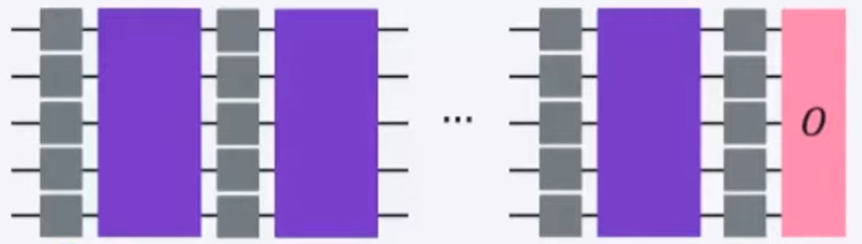
Noise induced barren plateaus
Gradients do vanish exponentially with depth, independently of using global or local measurements

Slide 14
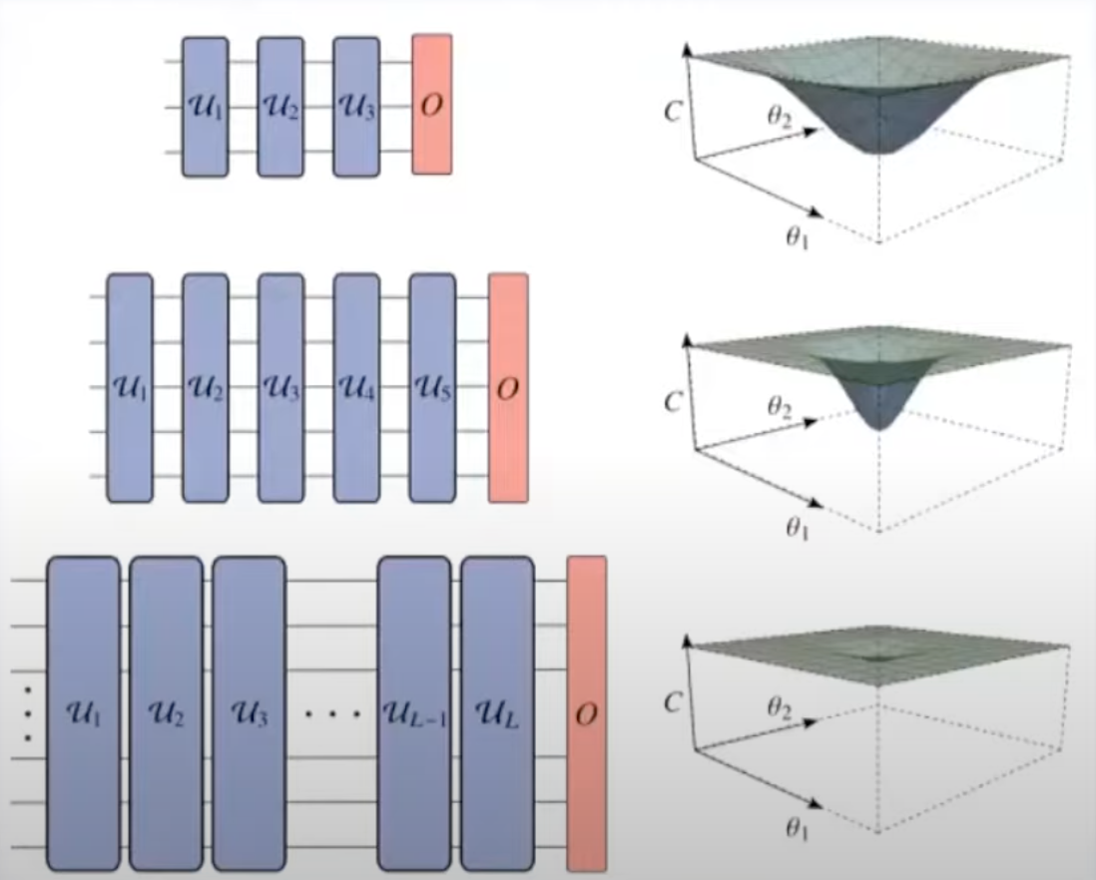
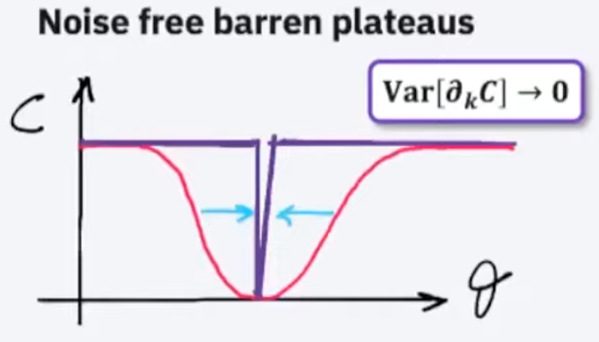
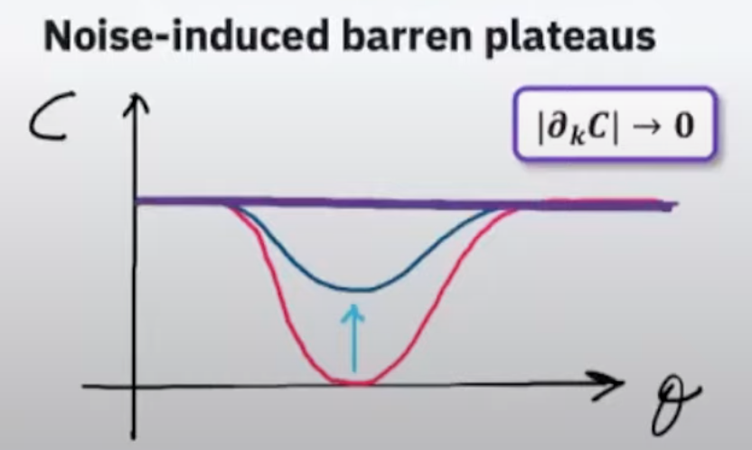
Noise induced barren plateaus

Slide 15
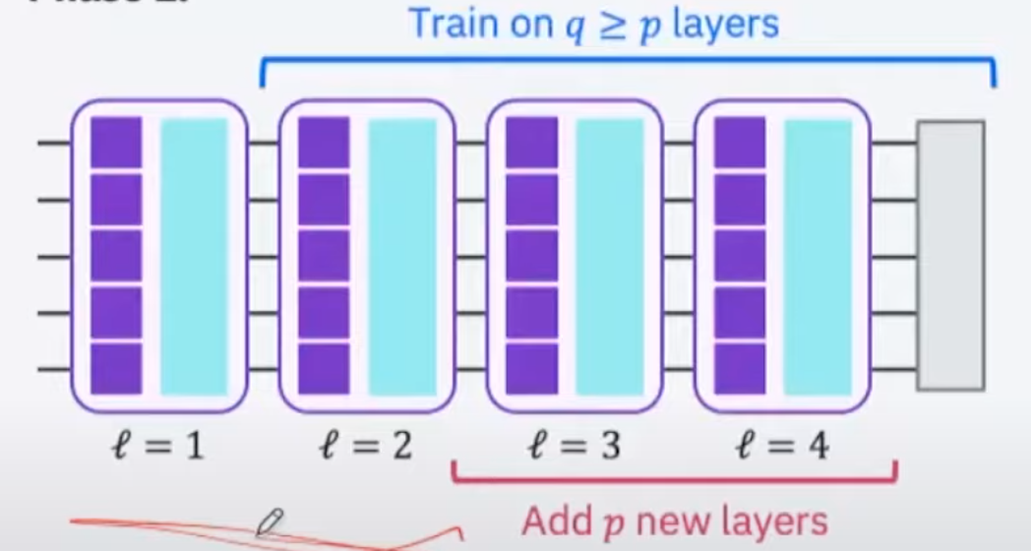
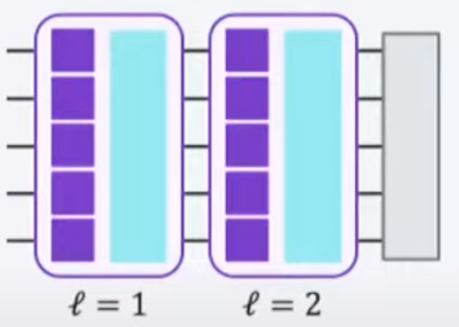
Mitigating barren plateaus: layerwise learning
Learn parameters of the first set of layers
Add layers, fixing the previous learnt parameters
Initialize the new set of layers parameters such that it implements identity

Slide 16
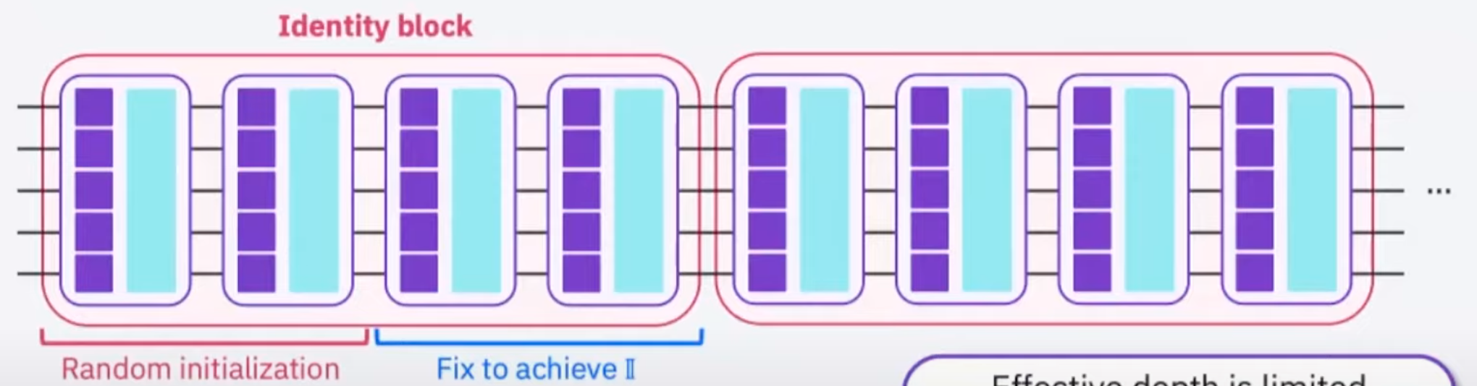
Mitigating barren plateaus: initialization
Effective depth is limited
The gradients will not vanish
exponentially fast at least in the 1st training step
Partition the circuit into shallow blocks
Initialize some parameters with random values
Fix the remaining such that the block implements identity

